Slide 1
Software Engineering (CSC205) gg BSCS/BS(SE)-III
Lecture 5-6

Slide 2
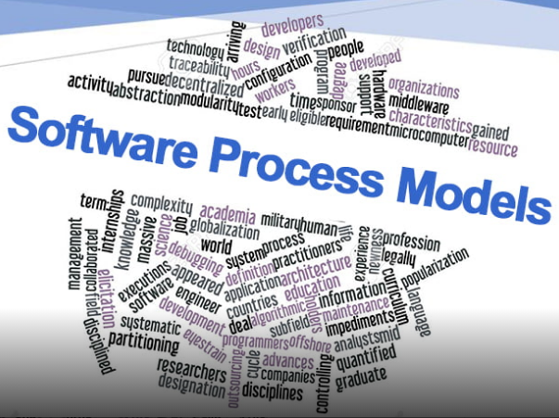
Topics
Process Models
RUP
Agile Models

Slide 3
The Unified Process (UP)
elaboration
inception

Slide 4
UP Phases

Slide 5
UP Work Products

Slide 6
Agile development
Program specification, design and implementation are inter-leaved
The system is developed as a series of versions or increments with stakeholders involved in version specification and evaluation
Frequent delivery of new versions for evaluation
Extensive tool support (e.g. automated testing tools) used to support development.
Minimal documentation – focus on working code

Slide 7
Plan-driven and agile development

Slide 8
Common Fears for Developers
The project will produce the wrong product.
The project will produce a product of inferior quality.
The project will be late.
We’ll have to work 80 hour/ week.
We’ll have to break commitments.

Slide 9
Plan-driven and agile development
Plan-driven development
A plan-driven approach to software engineering is based around separate development stages with the outputs to be produced at each of these stages planned in advance.
Not necessarily waterfall model – plan-driven, incremental development is possible
Iteration occurs within activities.
Agile development
Specification, design, implementation and testing are inter-leaved and the outputs from the development process are decided through a process of negotiation during the software development process.

Slide 10
Agile methods

Slide 11
The Manifesto for Agile Software Development
“We are uncovering better ways of developing software by doing it and helping others do it. Through this work we have come to value:
Individuals and interactions over processes and tools.
Working software over comprehensive documentation.
Customer collaboration over contract negotiation.
Responding to change over following a plan.
That is, while there is value in the items on the right, we value the items on the left more.”
-- Kent Beck et al.

Slide 12
What is “Agility”?
Effective (rapid and adaptive) response to change.
Effective communication among all stakeholders.
Drawing the customer onto the team.
Organizing a team so that it is in control of the work performed.
Yielding …
Rapid, incremental delivery of software.

Slide 13
An Agile Process
Is driven by customer descriptions of what is required (scenarios).
Recognizes that plans are short-lived.
Develops software iteratively with a heavy emphasis on construction activities.
Delivers multiple ‘software increments’.
Adapts as changes occur.

Slide 14
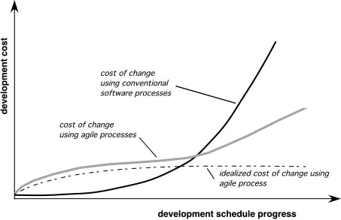
Agility and the Cost of Change

Slide 15
Agile Principles
Our highest priority is to satisfy the client through early and continuous delivery of valuable software.
Welcome changing requirements, even late in development. Agile processes harness change for the client's competitive advantage.
Deliver working software frequently, from a couple of weeks to a couple of months, with a preference to the shorter timescale.
Business people and developers must work together daily throughout the project.
Build projects around motivated individuals. Give them the environment and support they need, and trust them to get the job done.
The most efficient and effective method of conveying information to and within a development team is face-to-face conversation.
Working software is the primary measure of progress.
Agile processes promote sustainable development. The sponsors, developers, and users should be able to maintain a constant pace indefinitely.
Continuous attention to technical excellence and good design enhances agility.
Simplicity--the art of maximizing the amount of work not done--is essential.
The best architectures, requirements, and designs emerge from self-organizing teams.
At regular intervals, the team reflects on how to become more effective, then tunes and adjusts its behavior accordingly.
Notes:
Keys:
Changing requirements,

Slide 16
Human Factors
The process molds to the needs of the people and team, not the other way around.
Key traits must exist among the people on an agile team and the team itself:
Competence.
Common focus.
Collaboration.
Decision-making ability.
Fuzzy problem-solving ability.
Mutual trust and respect.
Self-organization.

Slide 17
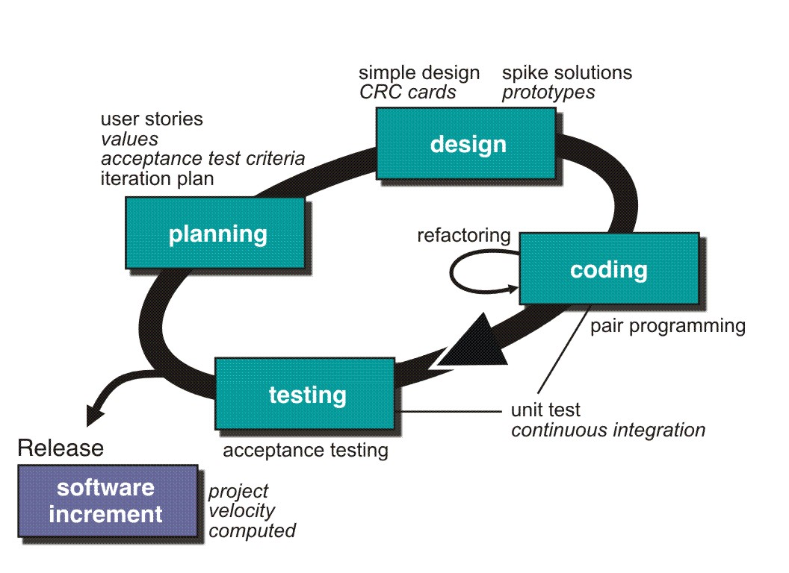
Example: Extreme Programming (XP)

Slide 18
Extreme programming practices
Principle or practice | Description
Incremental planning | Requirements are recorded on story cards and the stories to be included in a release are determined by the time available and their relative priority. The developers break these stories into development ‘Tasks’. See Figures 3.5 and 3.6.
Small releases | The minimal useful set of functionality that provides business value is developed first. Releases of the system are frequent and incrementally add functionality to the first release.
Simple design | Enough design is carried out to meet the current requirements and no more.
Test-first development | An automated unit test framework is used to write tests for a new piece of functionality before that functionality itself is implemented.
Refactoring | All developers are expected to refactor the code continuously as soon as possible code improvements are found. This keeps the code simple and maintainable.

Slide 19
Extreme programming practices
Pair programming | Developers work in pairs, checking each other’s work and providing the support to always do a good job.
Collective ownership | The pairs of developers work on all areas of the system, so that no islands of expertise develop and all the developers take responsibility for all of the code. Anyone can change anything.
Continuous integration | As soon as the work on a task is complete, it is integrated into the whole system. After any such integration, all the unit tests in the system must pass.
Sustainable pace | Large amounts of overtime are not considered acceptable as the net effect is often to reduce code quality and medium term productivity
On-site customer | A representative of the end-user of the system (the customer) should be available full time for the use of the XP team. In an extreme programming process, the customer is a member of the development team and is responsible for bringing system requirements to the team for implementation.

Slide 20
User stories for requirements
In XP, a customer or user is part of the XP team and is responsible for making decisions on requirements.
User requirements are expressed as user stories or scenarios.
These are written on cards and the development team break them down into implementation tasks. These tasks are the basis of schedule and cost estimates.
The customer chooses the stories for inclusion in the next release based on their priorities and the schedule estimates.

Slide 21
A ‘prescribing medication’ story

Slide 22
Examples of task cards for prescribing medication

Slide 23
Scrum
Scrum is an agile method that focuses on managing iterative development rather than specific agile practices.
There are three phases in Scrum.
The initial phase is an outline planning phase where you establish the general objectives for the project and design the software architecture.
This is followed by a series of sprint cycles, where each cycle develops an increment of the system.
The project closure phase wraps up the project, completes required documentation such as system help frames and user manuals and assesses the lessons learned from the project.

Slide 24
When Scrum can be applied?
Complex Projects.
Project with changing requirements.
Project with changing environment and conditions.
Project with uncertainties.
Project where all analysis (requirements, schedules, resource allocation) can not be done at the start (or at least not accurately).

Slide 25
Scrum Process … Outline
Start with Vision of what you want to achieve.
Come up with Core Requirements and priorities (Bare Minimum but good enough to get started) – Product Backlog
Team selects the requirements that it can implement in the first iteration (Planning Meeting)
Team defines tasks for completing requirements (Sprint Backlog)
Team goes in 30-Day Development Cycle (Sprint)
Team meets daily to sync up on progress (Daily Scrum)
Team goes through the complete process (design, development, testing, documentation) to complete an increment of functionality.
At the end of 30 day sprint, Team demonstrates completed functionality to bosses and stakeholders (Sprint Review)
Team analyses its Sprint performance (Sprint Retrospective)
Requirements are prioritized, redefined.
Team goes through the process again (Sprint 2, Sprint 3, …, Release)

Slide 26
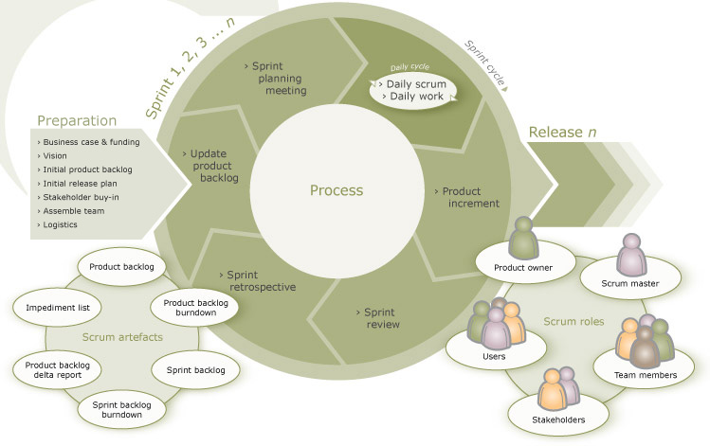
A Complete View

Slide 27
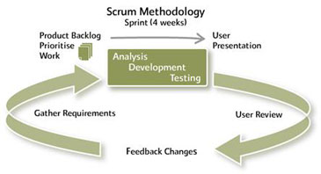
Scrum Process – Another Angle

Slide 28
The Committed People
There are 3 roles of the people who have committed themselves to the success of Scrum and are ultimately responsible for it.
Product Owner
Responsible for defining requirements of the project and their priorities.
The Team
The Cross-Functional Team that works on the Requirements defined and in the priority as given by the Product Owner. The Team is what carries out the Sprint.
Scrum Master
Member of Team that drives the Scrum. He guides the team and makes sure that Scrum is implemented.

Slide 29
Scrum Master …
Responsible for running the Scrum.
Plays the role of a facilitator, guider, trainer, motivator, impediment remover.
Scrum Master is NOT exactly Project Manager.
Should know more about the Scrum process than others.
Should be very clear on the philosophy behind Scrum principles.
Responsible for improving the overall working environment and conditions for the team.
Makes sure that the team is not obstructed in any way during the Sprint.
Ensures Scrum principles are followed.

Slide 30
Sprint Review
Conducted at the end of Sprint
Team demonstrates completed functionality in Sprint to Product Owner and Stakeholders
It’s the ‘inspection and adaptation’ part
Management can identify risks and opportunities
Product Owner and others can reprioritize the Product Backlog after this ‘feedback’

Slide 31
Sprint Review Rules
Team should not spend more than 1 hour to prepare
Only ‘done’ functionality is presented
Sprint Review involves team presenting functionality, answering questions and discussion
Everyone gives their feedback
Scrum Master schedules and conducts the meeting

Slide 32
Sprint Retrospective
Conducted after Sprint Review by the Team
They evaluate the just concluded Sprint
They discuss what went wrong, what went right and what needs to be changed and improved
The objective is to ensure that the next Sprint goes better than the current Sprint

Slide 33
Scrum Process - Meetings

Slide 34
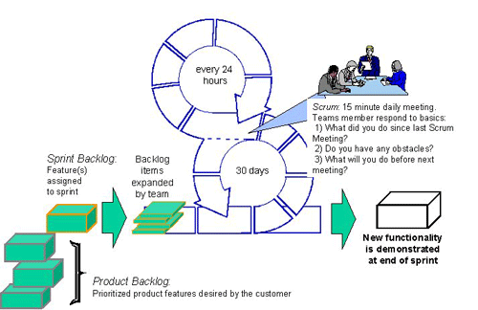
Daily Scrum Meeting

Slide 35
Daily Scrum – Rules
Chickens can attend – but cannot interfere
Every Team members answers 3 questions:
What has he done since last meeting?
What he plans to do between now and next meeting?
What impedes his work progress?
There should be no digressing beyond these 3 questions

Slide 36
Scrum of Scrums …

Slide 37
Scrum benefits
The product is broken down into a set of manageable and understandable chunks.
Unstable requirements do not hold up progress.
The whole team have visibility of everything and consequently team communication is improved.
Customers see on-time delivery of increments and gain feedback on how the product works.
Trust between customers and developers is established and a positive culture is created in which everyone expects the project to succeed.

Slide 38
Other Agile Processes
Adaptive Software Development (ASD)
Dynamic Systems Development Method (DSDM)
Crystal
Feature Driven Development
Agile Modeling (AM)

Slide 39

Model Selection
“…But we must try to understand it if we are to solve it.”
Fred Brooks, 1975

Slide 40
Exercise
List down key attributes/characteristics that help in selecting a process model or differentiating them.

Slide 41
References
Software Engineering, Sommerville, I., Chapter 2 & 3, 10th Edition (2016), Pearson.
Software Engineering: A Practitioner’s Approach, Pressman, R.S. & Maxim B., Chapter 2 & 3, 8th Edition (2015), McGraw-Hill.

